Slide 1


CELL FOUNDRY
Meeting Title: Project Plan
PAVIN SUMATHI PALANICHAMY · PRETHEBHA MUTHUKUMARAN · PRIYAM JHA
MENTOR: PROF. DR. MAGDA GREGOROVÁ
DATE: 08.10.2026

Slide 2
AGENDA
  CLIENT
  The problem and why it matters
  REQUIREMENTS AND DATA
  Scope: what’s in, what’s open
  Project plan: recommended work sequence
  ResOURCES AND RISKS
  MILESTONES
  TEAM
  TRACKING AND COMMUNICATION
  TECHNICAL WORK: APPROACH, ZERO-SHOT RESULTS, FINDINGS
  DELIVERABLES AND STATUS
CELL FOUNDRY
Meeting Title: Project Plan

Slide 3
CLIENT
IMES - InstitUT FÜR MEDIZINTECHNIK SCHWEINFURT, THWS. RESEARCH PARTNER
PROVIDER OF MICROSCOPY IMAGING DATA
BIOMEDICAL DOMAIN EXPERTISE.
CONTACTS:
NICOLE PAUL - IMMEDIATE POINT OF CONTACT AND THE ONE WHO WORKS WITH THE CODE
JAN HANSMANN - THE BIOLOGY EXPERT
CELL FOUNDRY
Meeting Title: Project Plan

Slide 4
Project description
PORCINE TISSUE: CULTURED MEAT (PRIORITY - CONFIRMED BY IMES - NICOLE)
LAB-GROWN MEAT IS PRODUCED FROM ANIMAL CELLS IN VITRO.
MUSCLE TISSUE ALONE DOES NOT REPRODUCE REAL MEAT’S FLAVOR, MOST OF THAT FLAVOR COMES FROM FAT, NOT MUSCLE.
FAT CELLS (ADIPOCYTES) ARE DELIBERATELY INCLUDED IN THE CULTURE TO CONTRIBUTE FLAVOR.
HUMAN TISSUE HAVE TWO PURPOSES
1) BIOMEDICAL RESEARCH: OBESITY, TYPE 2 DIABETES, METABOLIC SYNDROME
ADIPOCYTE SIZE AND COUNT ARE THE PRIMARY READOUTS.
2) DRUG TESTING: VIA THE HANNOVER COLLABORATION, CELL CULTURE AHEAD OF CLINICAL TRIALS.
CELL FOUNDRY
Meeting Title: Project Plan

Slide 5
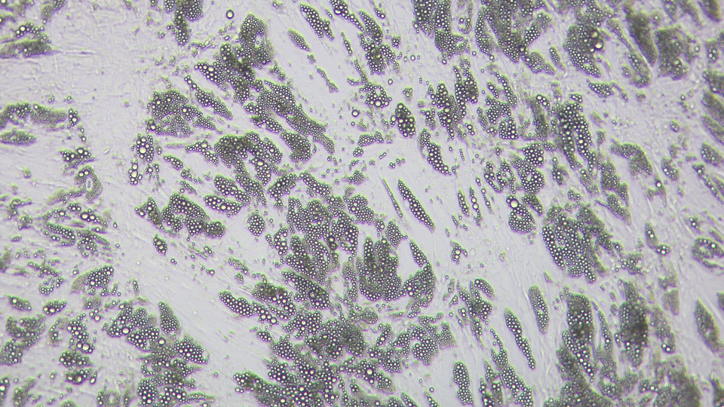
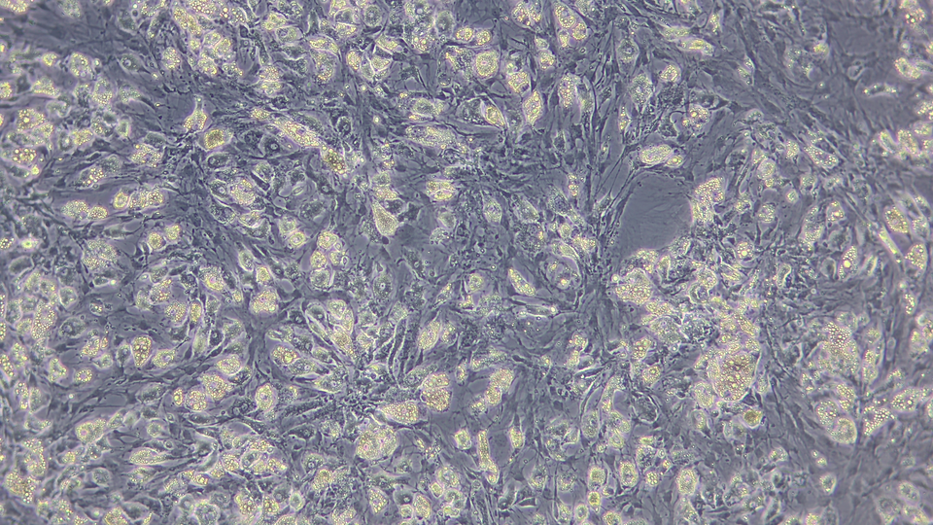
Cell Culture Description
MIXED POPULATIONS OF ADIPOCYTES AND STEM CELLS (BONE-MARROW DERIVED, CAPABLE OF BECOMING EITHER BONE CELLS OR ADIPOCYTES).
APPROXIMATELY 90% BECOME FAT CELLS, 10% REMAIN STEM CELLS BUT ONLY AN EXTERNALLY REPORTED ESTIMATE
Training Human bf
Training Porcine bf
CELL FOUNDRY
Meeting Title: Project Plan

Slide 6
Requirements (from IMES)
  RELIABLY SEGMENT INDIVIDUAL CELLS THAT ARE SUFFICIENTLY DISTINGUISHABLE FROM ONE ANOTHER.
  WITHIN LARGER CLUSTERS AND CONNECTED CELL AREAS, IDENTIFY INDIVIDUAL CELLS OR STRUCTURES AS FAR AS POSSIBLE, SO AT LEAST AN APPROXIMATE CELL COUNT CAN BE OBTAINED, BUT PARTIAL ANNOTAION WITH BETTER CONFIDENCE IS APPRECIATED (BY IMES).
  DISTINGUISH CELL STATE: ADIPOCYTE VS. STEM CELL, NOT JUST LOCATE AND COUNT ONE FIXED CELL TYPE.
PROBLEM:
NO TYPE LABELS EXIST, SO THIS MUST BE DONE VISUALLY.
CELL FOUNDRY
Meeting Title: Project Plan

Slide 7
Requirements (from IMES) - PRIORITY Confirmed
  PORCINE BRIGHTFIELD IS THE MAIN GOAL
  HUMAN ADIPOCYTE ANNOTATIONS WERE NOT FULLY TRUSTED EVEN BY IMES'S OWN BIOLOGISTS
  HUMAN SEGMENTATION IS LOWER PRIORITY.
  DIFFERENTIATED VS. UNDIFFERENTIATED DISTINCTION: STRETCH GOAL, "IF TIME PERMITS," NOT REQUIRED.
CELL FOUNDRY
Meeting Title: Project Plan

Slide 8
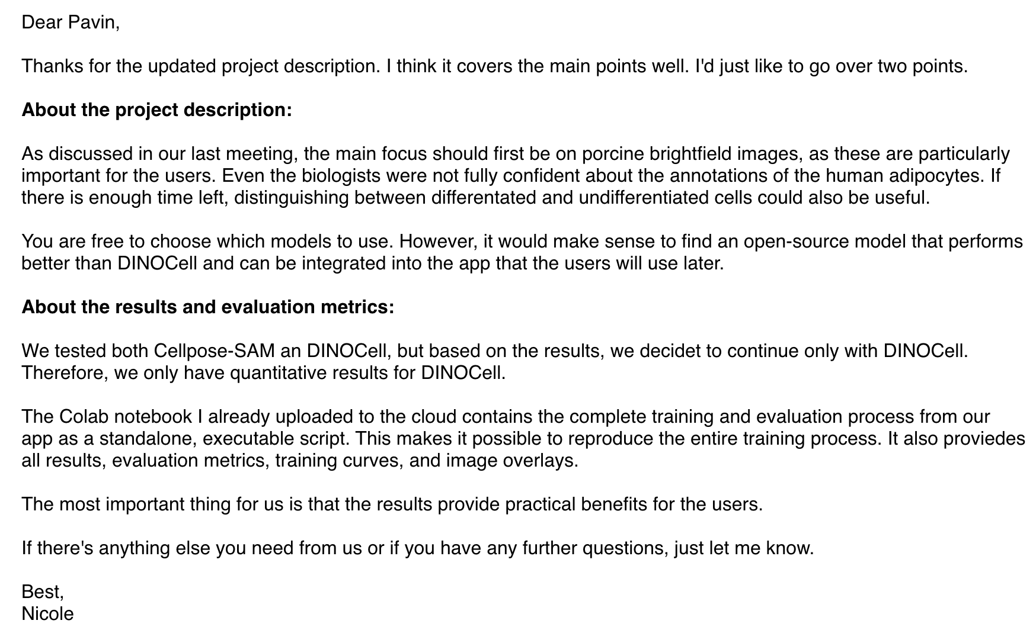
WE DONT HAVE TO REPRODUCE THE CELLPOSE RESULTS
ONE ISSUE: ADDRESSED IN THE COMING SLIDE

Slide 9
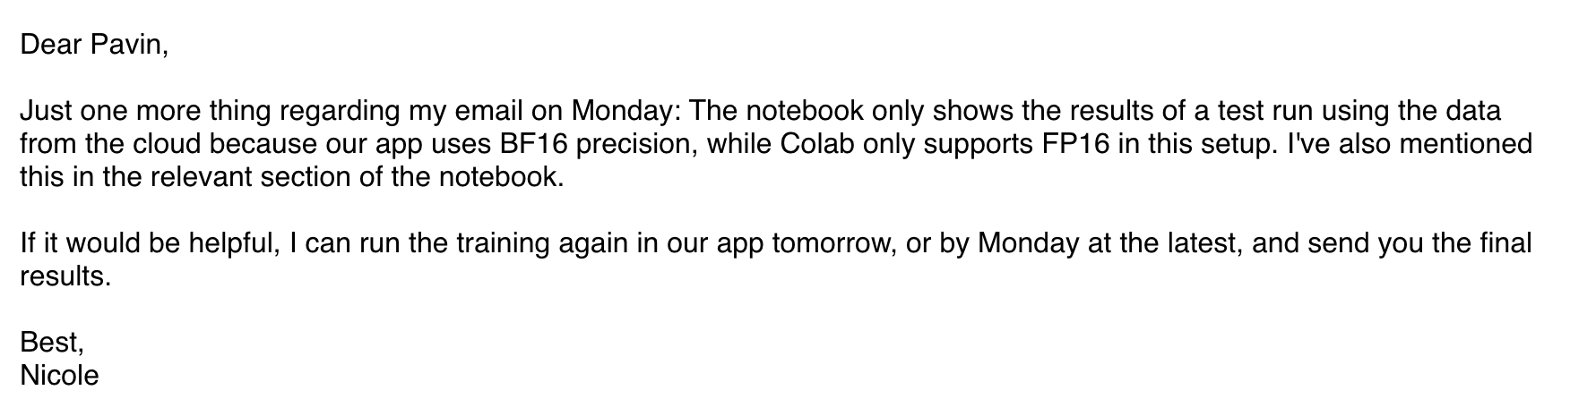

Slide 10
Data (so far)
Microscopy images with instance-segmentation masks, shared via THWS Cloud, in four groups by species and modality.
Group | Pairs | Image format | Mask format | Resolution
Training_human_bf | 15 | PNG | TIF | 1920 × 1080
Training_human_ph | 11 | TIF | TIF | 1408 × 1040
Training_porcine_bf | 28 | PNG | TIF/TIFF/PNG | 1920 × 1080
Training_porcine_ph | 25 | PNG | TIF/TIFF | 1408 × 1040
Total Images so far: 79 (NEED MORE DATA)
CELL FOUNDRY
Meeting Title: Project Plan

Slide 11
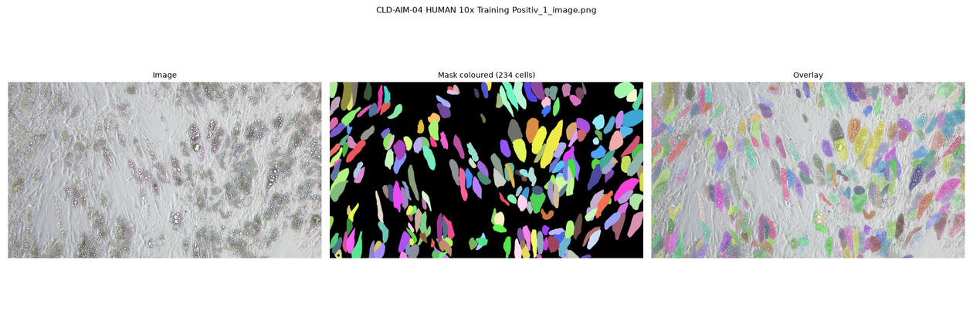
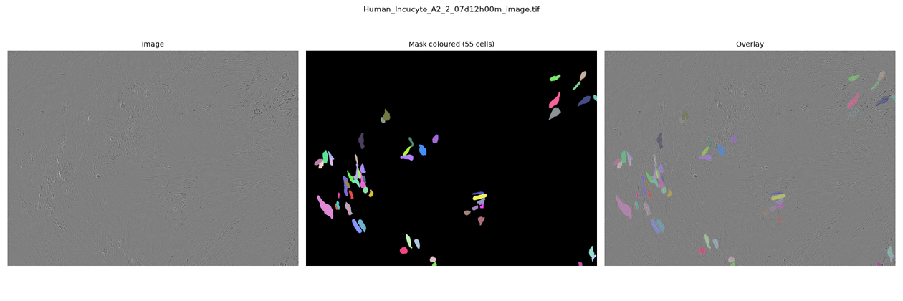
Training_Human_bf
Training_Human_ph
CELL FOUNDRY
Meeting Title: Project Plan

Slide 12
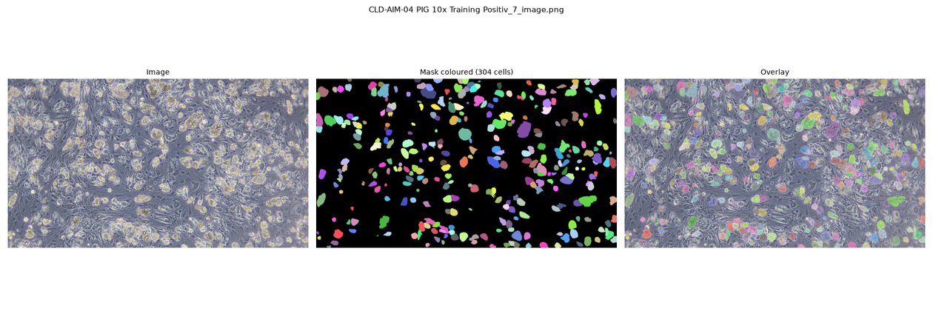
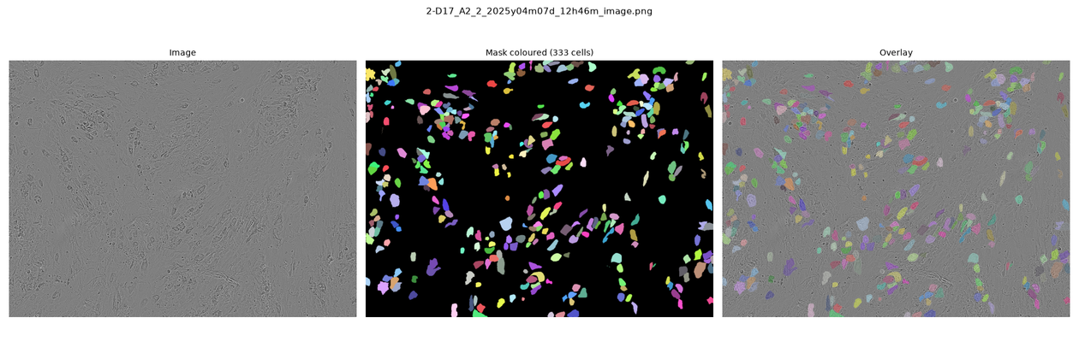
Training_porcine_bf
Training_porcine_ph
CELL FOUNDRY
Meeting Title: Project Plan

Slide 13
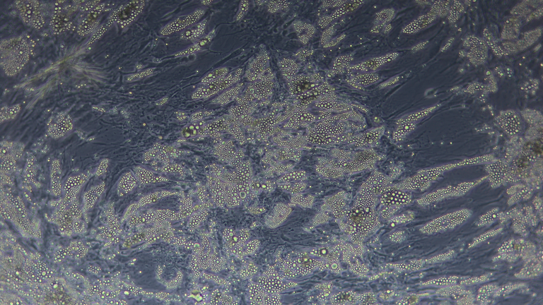
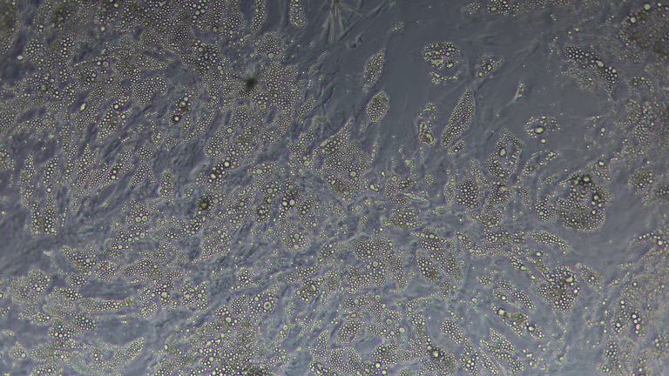
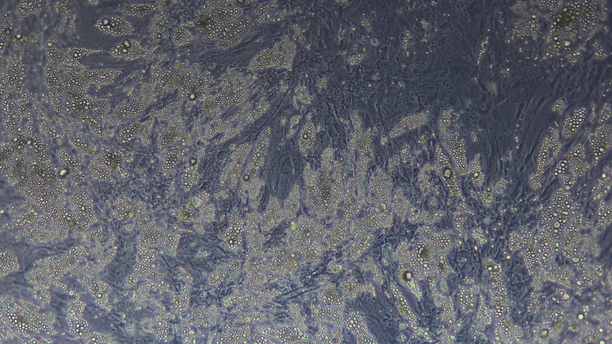
Data (Continued...)
MASKS ARE SINGLE-CHANNEL INSTANCE-LABEL IMAGES.
A 36 ADDITIONAL UNANNOTATED HUMAN BRIGHTFIELD IMAGES - COULD BE USED FOR PSEUDOLABELING
CELL FOUNDRY
Meeting Title: Project Plan

Slide 14
Data (Continued...)
  A REAL TIME DIFFERENTIATION DIMENSION EXISTS IN THE DATA.
  PORCINE PHASE-CONTRAST HAS DIFFERENTIATION DAY (E.G. 7-D0, 19-D14).
  CELL COUNT CLIMBS SHARPLY OVER TIME: AS FEW AS 2 LABELED CELLS AT DAY 0, UP TO 325+ BY DAY 14 IN ONE SERIES.
  CLUSTERS FORMS OVER TIME
CELL FOUNDRY
Meeting Title: Project Plan

Slide 15
Data (New Data Uploaded...)
UNANNOTATED DATA (FOR PSEUDO-LABELING)
  105 ADDITIONAL UNANNOTATED PORCINE BRIGHTFIELD IMAGES (1920×1080, PNG)
  36 ADDITIONAL UNANNOTATED HUMAN BRIGHTFIELD IMAGES (1920×1080, TIFF)
CELL FOUNDRY
Meeting Title: Project Plan

Slide 16
Scope: What’s In, What’s Out
SPECIES PORCINE AND HUMAN BOTH IN SCOPE; PORCINE IS THE EASIER CASE.
MIRCOSCOPY BRIGHTFIELD AND PHASE-CONTRAST BOTH IN SCOPE; NEITHER PRIORITIZED.
PREPROCESSING NECESSARY, NOT OPTIONAL. (ILLUMINATION CORRECTION, CONTRAST ENHANCEMENT (E.G. CLAHE) AND INTENSITY
NORMALISATION, AND CAREFUL DATA AUGMENTATION (GEOMETRIC TRANSFORMATIONS, INTENSITY JITTER,
ELASTIC DEFORMATIONS)
BASELINE MODELS BASELINE MODEL: DINOCELL ONLY (NICOLE, EMAIL 1). IMES TESTED BOTH CELLPOSE-SAM AND DINOCELL, DECIDED
TO CONTINUE WITH DINOCELL ONLY.
CELLPOSE-SAM IS NO LONGER A BASELINE TO BEAT OR COMPARE AGAINST.
MODELS TO EXPLORE MICROSAM,, CELLSAM,, OWLV2,, SOWLV2,, OMNIPOSE,, MEDSAM,, SAM3-ADAPTER (OPTIONAL),, MEDICAL SAM3
(OPTIONAL),, DBSCAN
(ANY REPLACEMENT MUST BE OPEN-SOURCE AND INTEGRABLE INTO IMES'S APP NOT JUST A BENCHMARK WINNER.
EVALUATION METRICS NOT DECIDED YET (UPCOMING SLIDE)
WHAT’S OUT
  SAM3 TEXT PROMPT CAPABILITIES (ONLY SEGMENTATION IS NEEDED) - COULD BE TRIED IF TIME PERMITS
CELL FOUNDRY
Meeting Title: Project Plan

Slide 17
Recommended Work Sequence - advised by IMES
  Set up a rough draft milestones
  Data understanding
  Preprocessing of images
  Determining evaluation metrics IMES already uses and what they agree upon.
  Reproduce IMES’s own prior /Dinocell results as baseline.
  Segment porcine cells first (the easier case, to establish a working pipeline.
  Segment human cells (partial, high-confidence-only segmentation is acceptable.)
Additional Improvements
  Compute cell count.
  Compute cell size and morphology, including width-to-length ratio per cell.
  Apply pseudo-labelling to currently unannotated IMES images.
ALSO
POSTER PREPARATION
PAPER WRITING
CELL FOUNDRY
Meeting Title: Project Plan

Slide 18
Recommended Work Sequence - advised by IMES
  "REPRODUCE NICOLE'S RESULTS" - CONCRETE SOURCE
  her Colab notebook is the complete, training + evaluation pipeline (metrics, training curves, image overlays).
  Colab only supports FP16, IMES's real app trains in BF16, and precision affects results.
  She is re-running training in the real app, final BF16 results expected by Monday at the latest.
DO NOT TREAT THE COLAB RUN'S NUMBERS AS THE REPRODUCTION TARGET YET.
CELL FOUNDRY
Meeting Title: Project Plan

Slide 19
Resources
  Data: IMES-provided images and masks.
  Compute: local GPU usable for inference
  Training compute: CAIRO, GPU Cluster???
Risks
  Metric ambiguity
  Baseline reproduction: must match BF16 app results, not the FP16 Colab test run shared.
  Visualalization (empty space = stem cell, dotted/textured regions ≈ adipocyte. Checked on real images but not yet systematic)
  Human tissue is harder and more data-sparse than porcine.
CELL FOUNDRY
Meeting Title: Project Plan

Slide 20
# | Milestone | Work | Suggested owner
1 | Metric selection + baseline benchmarking | Determine IMES's metrics; get Nicole's prior results | Yet to decide (flexible, depending on availability)
2 | Metric selection + baseline benchmarking | Reproduce DINOCell baseline | —
3 | Metric selection + baseline benchmarking | Establish Dinocell baseline on porcine data | —
4 | Porcine segmentation pipeline | Preprocessing (CLAHE, normalization, illumination) | —
5 | Porcine segmentation pipeline | Porcine brightfield segmentation | —
6 | Porcine segmentation pipeline | Porcine phase-contrast segmentation | —
7 | Cell count + size/morphology | Width-to-length ratio across annotated cells | —
— | Human segmentation (not yet an issue) | Human brightfield/phase, partial/high-confidence | —
— | Pseudo-labeling (not yet an issue) | Apply to 36 new unannotated images + rest | —
CELL FOUNDRY
Meeting Title: Project Plan

Slide 21
TEAM
Role | Person
Team member | Pavin Sumathi Palanichamy
Team member | Prethebha Muthukumaran
Team member | Priyam Jha
Mentor | Prof. Dr. Magda Gregorová
Client contacts | Nicole Paul, Jan Hansmann (IMES)
CELL FOUNDRY
Meeting Title: Project Plan

Slide 22
Roles
NOT FORMALLY DECIDED
ONE WOULD TAKE OWNERSHIP EVERY WEEK
Possible Roles
  Data Part: owns communication with Nicole/Jan, tracks open questions, brings back answers (pavin, prethebha, priyam)
  Pipeline Part: owns preprocessing, evaluation and repo health keeping (pavin, prethebha, priyam)
  Modeling Part: owns running and comparing candidate models against the baseline (pavin, prethebha, priyam)
Everybody’s contribution will be visible via branch and git commits and a report on what’s done every week/milestone
CELL FOUNDRY
Meeting Title: Project Plan

Slide 23
Tracking and Communication
Github Repository & Github Project board (Under Github Organizations)
  GitHub org cell-foundry-team, team + mentor as members.
  Branch protection on main: PR + review required
  Labels by species, modality, work type.
  Milestones mirroring the work sequence.
  Project Board: Backlog → In Progress → In Review → Done.
  Minutes written up and committed after every meeting. (kickoff meeting already logged)
  Mentor meetings: biweekly, 1 hour, slides before, minutes both in git.
Link
Discord: for communication between teammates
Link
Rule of thumb: anything that’s a permanent record goes in git; day-to-day coordination goes in chat.
CELL FOUNDRY
Meeting Title: Project Plan

Slide 24
Evaluation Metrics
Pixel-level evaluation metrics
  Dice = 2·TP / (2·TP + FP + FN)
  IoU = TP / (TP + FP + FN)
  Precision = TP / (TP + FP)
  Recall = TP / (TP + FN)
Instance-level evaluation metrics
  Predicted flows are converted into actual separated instance masks via cellpose.dynamics.compute_masks
  Matched against ground truth using cellpose.metrics.average_precision at IoU threshold 0.5 (instance_iou_threshold in config)
  From that: instance precision, instance recall, instance F1, plus raw instance TP/FP/FN counts
SAM Paper revealed that even models with higher mIOU scores performed worse when actual human annotators checked the results, THUS EVALUATION METRICS ARE YET TO BE DISCUSSED BY THE IMES (WHETHER TO STICK WITH HUMAN ANNOTATION OR QUANTIFIABLE METRICS)
What to do:
NICOLE’S CODE COULD BE the actual IMES evaluation pipeline, "the complete training and evaluation process from our app."
But its printed results so far are FP16 (Colab-limited), not BF16 (the app's real precision), wait for Monday's BF16 results.,
CELL FOUNDRY
Meeting Title: Project Plan

Slide 25

5 · TECHNICAL WORK & EVALUATION
Technical Approach
  Baseline first: run existing models zero-shot (no training) on IMES images. Done for porcine brightfield with 4 Cellpose models.
  Benchmark every model the same way: same images, same settings, same scoring code.
  Extend step by step: the other 3 image groups, then micro-SAM, CellSAM, DINOCell, SAM3 / Medical SAM3.
  Fine-tune the best 1–2 models on leakage-free splits (no image in both training and test).
  Porcine cells first (easier), then human cells (harder).
Rule: change one thing at a time, and save every run with its settings so it can be reproduced.
CELL FOUNDRY
Meeting Title: Project Plan

Slide 26
5 · TECHNICAL WORK & EVALUATION
What Is Built So Far
  Environment “cf-core”: pinned versions (Python 3.12, PyTorch 2.12 + CUDA 13.2, Cellpose 4.2.1, micro-SAM 1.8.14, DINOv3), tested on our 8 GB laptop GPU
  run_cpsam.py: one image → masks, scores and an overlay picture
  run_batch.py: all images × all models → per-image table, summary table, masks, overlays and the exact run settings
  score_masks.py: one shared scoring code, so every model is scored the same way
  Reproducible: two full benchmark runs gave identical numbers
  Pure zero-shot so far: no training, no own preprocessing, default model settings
Tried and dropped: density clustering of lipid droplets (DBSCAN / HDBSCAN)
It splits single cells or merges touching cells. Droplets inside a cell are as close together as droplets across a cell edge, so droplet positions alone cannot separate touching cells (the same weakness as the current IMES tool).
CELL FOUNDRY
Meeting Title: Project Plan

Slide 27
5 · TECHNICAL WORK & EVALUATION
How We Scored the Benchmark
  Matching: each predicted cell is paired with at most one annotated cell. Overlap = IoU = shared area ÷ combined area (1 = identical)
  TP = correct cell (IoU ≥ 0.5) · FP = false detection · FN = missed cell
  Precision = TP ÷ cells found · Recall = TP ÷ cells annotated
  F1@0.5 = 2·TP ÷ (2·TP + FP + FN) → headline score: “was the cell found?”
  F1@0.75 = the same with overlap ≥ 0.75 → outline accuracy (matters for cell size)
  Count error = (cells found − cells annotated) ÷ cells annotated
  Splitting one cell into two halves gives 1 TP + 1 FP, so over-segmentation is punished
  Two summaries: mean over images (every image equal) and pooled over all cells (every cell equal); control wells reported separately
Proposal: use F1@0.5 + count error as working metrics until IMES confirms what “at least 70%” refers to.
CELL FOUNDRY
Meeting Title: Project Plan

Slide 28
5 · TECHNICAL WORK & EVALUATION
Zero-Shot Results: Porcine Brightfield
Metric
cpsam_v2
cpsam
cpdino
cpdino-vitb
F1@0.5, mean ± SD
0.43 ± 0.26
0.47 ± 0.27
0.62 ± 0.24
0.65 ± 0.14
Pooled F1@0.5 (all cells together)
0.28
0.29
0.51
0.65
F1@0.75 (outline accuracy)
0.28
0.28
0.38
0.37
Cells found (8,196 annotated)
19,798
19,301
12,981
7,474
Total count error
+142%
+136%
+58%
−9%
Time / GPU memory per image
3.7 s / 1.6 GB
3.7 s / 1.6 GB
3.6 s / 1.3 GB
1.7 s / 0.7 GB
Zero-shot, default settings · 25 differentiated porcine brightfield images, 8,196 annotated cells · bold = best per row
cpsam_v2 / cpsam = Cellpose-SAM (current / original weights) · cpdino / cpdino-vitb = Cellpose with a DINOv3 backbone (large / base)
DINOv3 models beat Cellpose-SAM on 24 of 25 images (p < 0.001); Cellpose-SAM finds ~2.4× too many cells.
CELL FOUNDRY
Meeting Title: Project Plan

Slide 29
5 · TECHNICAL WORK & EVALUATION
Findings → Proposals
1. Large lipid droplets are outlined as separate cells
→ Proposal: fine-tune on IMES masks, starting with cpdino-vitb (most robust, fits our 8 GB GPU)
2. cpdino draws the best outlines; cpdino-vitb never collapses
→ Proposal: keep both as zero-shot references; drop cpsam_v2 as the default reference
CELL FOUNDRY
Meeting Title: Project Plan

Slide 30
5 · TECHNICAL WORK & EVALUATION
Limits & Next Steps
Limits
Next steps
  Run the other 3 image groups
  Add micro-SAM to the same pipeline
  Set up DINOCell, CellSAM, SAM3 / Medical SAM3
  Leakage-free splits (by series and condition)
  Fine-tune the best 1–2 models
  Send IMES a short summary + open questions
  Only 1 of 4 image groups tested (porcine brightfield, 28 images)
  Default settings, nothing tuned, no training yet
  The “typical vs difficult images” split was chosen after seeing the results
  Annotation rule (only fat cells?) and the “at least 70%” target are not confirmed yet
CELL FOUNDRY
Meeting Title: Project Plan

Slide 31
6 · DELIVERABLES
Deliverables
For IMES (client)
For the course
  Documented, reproducible evaluation pipeline (code, environment, settings)
  Benchmark of all candidate models per image group (same images, same scoring)
  Recommended model, fine-tuned on IMES data
  Readouts per image: cell count, cell-size distribution, per-cell masks (exact form yet to confirm with IMES)
  Code handover with a short user guide
  Mid-term poster
  Short paper / report
  Live demo
  Git repository: code, minutes, meeting slides, decision log
Stretch goal: pseudo-labelling on the unannotated IMES images
CELL FOUNDRY
Meeting Title: Project Plan

Slide 32
6 · DELIVERABLES
Status (8 October 2026)
✓ Done
◐ In progress
○ Planned
  Understood data and visualized the problems
  Updated project brief to the IMES’s requirement
  Milestones and communication channels set.
  cf-core environment (pinned versions, GPU-verified)
  Evaluation scripts: single image, batch, shared scoring
  Zero-shot benchmark: 4 Cellpose models on 28 porcine brightfield images
  Density-clustering test (dropped)
  Creating seperate and reproducible environments for the other models
  Refresh the environment file
  Open questions to IMES: metric, annotation rule, image labels
  Other 3 image groups
  micro-SAM, DINOCell, CellSAM, SAM3 / Medical SAM3
  Leakage-free splits + fine-tuning
  Human cells
  Poster, paper, live demo
CELL FOUNDRY
Meeting Title: Project Plan

